Slide 1
Lunch & Learn
Sept 6, 2023

Slide 2
Table of Contents
Introduction
Quality Measures
Star Ratings
Medicare Enrollment Timeline
Growth Strategies
Patient Communication
Permissible Provider Activities
Non-Permissible Provider Activities
Provider Education
Balance Billing
Medical Record Audit Report
Additional Training Opportunities

Slide 3
Provider Relations Team
Contact Info:
Sarah Hernandez, Provider Relations Representative
Phone: 775.418.4913
Office: 520 W. 6th St, Reno, NV 89503
Cari Herrera, Director of Provider Relations
Phone: 503.400.7668
Email: providerrelations@atriohp.com

Slide 4

Who is ATRIO Health Plans?
ATRIO Health Plans was established by a Trio of physicians in 2004, almost 20 years ago in Salem, OR and now has serviced members in Douglas, Josephine, Jackson, Klamath, Marion and Polk counties.
In 2020, we expanded to Northern Nevada to service Carson City, Churchill, Douglas, Lyon, Storey & Washoe counties.
ATRIO Health Plans fosters a culture of compassion, capability, and customer service.
We work closely with local providers of care to improve health outcomes for our members and the communities we serve.
Our mission is to deliver high quality health insurance at a reasonable price, leverage the talents of our people, and foster deeper community connections.
Confidential – Not Intended for Distribution
Value. Compassion. Service.

Slide 5
Quality Control Team
Contact Info:
Jessica Assefa, Chief Quality Officer
Phone: 763.317.1921
Email: Jessica.Assefa@atriohp.com

Slide 6
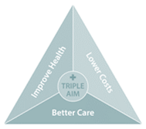
Star Ratings Purpose & Intent
  CMS publishes Star Ratings each year to:
  Measure quality in MA and Part D plans,
  Assist beneficiaries in finding the best plan for them, and
  Determine MA Quality Bonus Payments (QBPs).
  CMS uses Star Ratings to support public reporting and transparency by posting Star Ratings on Medicare Plan Finder (MPF).
  CMS evaluates progress toward the Triple Aim through Star Ratings:
  Improving the patient experience of care (quality, access, reliability),
  Improving the health of populations, and
  Reducing or controlling the cost of healthcare.
  CMS also uses Star Ratings as a basis for compliance and enforcement actions, to identify audit candidates, and to support decisions for application approvals and denials.
4X
weight
Patient Experience
Patient experience measures reflect beneficiaries’ perspectives of the care they received.
4X
weight
3x
weight
Outcomes
3X
weight
1x
weight
Intermediate outcomes
Process
Access
Access measures reflect processes and issues that could create barriers to receiving needed care. Plan Makes Timely Decisions about Appeals is an example of an access measure.
Outcome measures reflect improvements in a beneficiary’s health and are central to assessing quality of care.
Intermediate outcome measures reflect actions taken which can assist in improving a beneficiary’s health status. Diabetes Care – Blood Sugar Controlled is an example of an intermediate outcome measure where the related outcome of interest would be better health status for beneficiaries with diabetes.
Process measures capture the health care services provided to beneficiaries which can assist in maintaining, monitoring, or improving their health status.
Notes:
Claims Team

Slide 7
STAR RATINGS DATA SOURCES and
Measure Composition
HEDIS® | CAHPS |  | HOS
Developed and maintained by the National Committee for Quality Assurance (NCQA) Designed to allow consumers to compare performance to other plans and/or benchmarks Comes from surveys, insurance claims, medical charts The industry’s most used source of clinical quality measures | Data comes from a series of patient surveys rating healthcare experiences Focus on healthcare quality aspects that patients find important and are well equipped to assess CAHPS surveys are funded and overseen by the Agency for Healthcare Research and Quality (AHRQ) but must be administered by a qualified vendor |  | First patient-reported outcomes measures used in Medicare A random sample of Medicare beneficiaries is drawn and surveyed from each participating Medicare Advantage Organization. The same group of members is resurveyed after 2 years to evaluate how effectively the MA plan has maintained or improved the health of those surveyed
Pharmacy - PDEs |  | ADMINISTRATIVE DATA
Every time a beneficiary fills a Part D prescription, the plan sponsor must submit a summary record to CMS called the prescription drug event (PDE) data |  | CMS collects Medicare enrollment, spending, and claims data to monitor and evaluate access to care and quality of care, trends in utilization, changes in payment policy, and other program-related issues

Slide 8

What ATRIO Health Plans is doing to improve Star Ratings
ATRIO’s Top Priorities Include:
Ensuring our members have access to high-quality plans with an overall Star rating of four stars or higher.
Helping our members maintain or improve their overall health and wellbeing.
Examples of ways we are working to achieve our mission include:
Arming providers with timely, actionable patient health information. This includes the latest care gaps report.
Rewarding members for completing Annual Wellness Visits or Annual Check Ups.
Providing a dedicated team focused on improving our Star Ratings for the quality care measures with room for Star score improvement.
Working with Care Management, Health Care Quality, and our network providers to help our members stay healthy by evaluating how often members receive screenings, vaccines, checkups, and other preventive services and helping them to close their care gaps.

Slide 9
What ATRIO Health Plans is doing to improve Star Ratings
One of ATRIO’s main missions is to ensure our members continue to have access to high-quality plans with an overall Star rating of four stars or higher. Through our Medicare Advantage plans we aim to help our members maintain or improve their overall health and wellbeing.
Examples of ways ATRIO is working to achieve this mission include:
Arming providers with timely, actionable patient health information and helpful resources that improve quality of care.
Rewarding members for completing Annual Wellness Visits or Annual Check Ups.
Providing a dedicated team focused on improving our Star Ratings for the quality care measures with room for Star score improvement.
Working with our network providers to help our members stay healthy by evaluating how often members receive screenings, vaccines, checkups, and other preventive services and helping them to close their care gaps.

Slide 10
How Providers Can Help
Manage chronic conditions
Track hemoglobin A1c (HbA1c) tests for diabetic members & adjust therapy as needed to achieve a HbA1c of less than 9.
Ensure patients with diabetes receive kidney health evaluation (estimated glomerular filtration rate (eGFR) & urine albumin-creatinine ratio (uACR) & retail eye exams and that results are documented in your records annually.
Make the primary care physician the orchestrator of care to ensure positive patient outcomes
Ensure patients discharged from the hospital or ED are scheduled to see a PCP within 7-10 days of discharge to prevent possible readmissions.
Transitions from care settings should be closely monitored & coordinated through the PCP practices to ensure the best health outcomes.
Safeguard patient satisfaction levels
Refer all patient complaints about ATRIO directly to the health plan for timely resolution.
Optimize anti-hypertensive medications in your patients with hypertension. If their BP is elevated, continue to treat and monitor until it comes down to the normal range
Ensure patents know what to do when in need of urgent care during & after-hours, and that patients receive care coordination services from their PCP (i.e., follow-up appointments, tests, referrals to specialists)
Address members' mental and physical health during the office visit.
Make customer service the highest priority within your practice setting.
Ensure patients know the importance of taking their medications to maximize the benefits of their treatment
Assist patients with medication adherence goals to support the treatment of diabetes, hypertension, & cholesterol control.
Help identify barriers to adherence.
Encourage patients with multiple conditions & medications to participate in ATRIO’s program for Medication Therapy Management (MTM). If a pharmacist contacts you about recommendations as a result of a MTM review, review the suggested recommendations.
Ensure patients discharged from hospitals or skilled facilities have their current medications reconciled against their discharge medications within 30 days of discharge

Slide 11
Timeline
Quarter 1 | Quarter 2 | Quarter 3 | Quarter 4
OEP
Age/Move Ins
SNP/SEP
AEP

Slide 12

Growth Strategies
Keep Patients
Patients Stay and Tell Others
The Right Plan
Medicare to MA Age Ins
New Patients
Move Ins, Organic Growth
Keep Patients
Patients Stay and Tell Others
The Right Plan
Medicare to MA; Age Ins
New Patients
Move Ins, Organic Growth
Activity In-Clinic: Patient Appreciation events; patient orientations; referral programs; surveys Direct outreach to patients (email; text; social; phone; direct mail) Main Message: We are honored to care for you; Stay with your Doc; Refer a friend Outcome: Stickiness with Doctor and care team; Advocate; refers friends | Direct to Patient: Brokers assigned to clinic; patient education events; AEP clinic tool kit; training and scripting teams; direct outreach to patients (email; text; social; phone; direct mail) Main Message: Does your plan provide you with the benefits you need; we can help; Are you getting the benefits you deserve? Outcome: Patients with appropriate coverage/funding; educated about benefits of MA | Direct to Community: Broker programs/tools; community events, doctor talks; digital/social; paid media – print, outdoor, TV, direct mail; email campaign Main Message: Trust us with your care; a better experience; strong network; more services Outcome: New patients acquired from others or capture of new people to the market
Value. Expertise. Service.

Slide 13


PATIENT COMMUNICATIONS
In-Clinic Road Map
Appointment Scheduling
Reception
Reminds patient that it’s Medicare Annual Election Period. Encourages them to talk to their provider at their next visit about the benefits of a Medicare Advantage Plan and ask if they can assist them with any information. If “yes”, forward patient to Practice Manager to follow up.
  GOAL:
  Better Care: Improving the patient experience. Informing the patient about their health plan options.
  Better Health: Encourage patients to review their health plan’s benefits annually to ensure it meets their current needs.
  Lower Cost: Aligning patient’s needs with available benefits to help them save money.
Greets patients. Hands survey to patients who may benefit from a Medicare Advantage plan.
In-Room Signage
Patient see reminders about Medicare AEP.
Provider
Checkout
5
Encourages patients to review his/her options during AEP. Answers patient’s questions. Connects patient with broker (or someone in office who can connect with broker).
Collect Permission to Contact Form if applicable & give to the PSS to assigned agent
7
6
Patient At Home
Receives reminders and invites via direct mail, phone calls, text messages, email, etc. encouraging them to consider their options, visit website.
Waiting Room
8
9
Patient sees collateral, brochures, ads, and signage, visits website.
Medical Assistant
Broker
Asks patients if they have questions about AEP; Review survey to identify areas where the patient may need additional services. Encourages patients to talk to provider/broker.
Answers patient’s questions and presents options to meet their needs.
If broker is in the clinic for office hours, clinical team should introduce patient to broker before they leave.
If broker is NOT in clinic, team should give the patients the assigned brokers’ cards.
Value. Expertise. Service.

Slide 14
Activities in a Healthcare Setting
Provider-Initiated
Activities conducted by a provider at patient’s request are not considered marketing and may occur where care is delivered
Oversight required
Provider contracts should indicate the need for
providers to remain neutral when assisting beneficiaries
Plan-Initiated
Activities conducted by a provider
(or Organization) at the Organization’s request are considered marketing and
are prohibited from occurring where care
is delivered.
Oversight required
Organizations should ensure all appropriate guidance is being followed in the healthcare setting
VS.
Confidential – Not Intended for Distribution

Slide 15
Permissible Provider Activities
Distributing unaltered, printed materials created by CMS, such as “Medicare & You” handbook.
Providing the names of Plans/Part D sponsors with which they contract and/or participate.
Answering questions or discussing the merits of a plan or plans, including cost sharing
and benefit information.
Referring patients to other sources of information such as State Health Insurance.
Referring patients to Plan marketing materials available in common areas.
Educational outreach to Medicare beneficiary to make aware of available plans and services
Mail affiliation letters to current patients.
Refer patients to agents to learn more about their options.
Providing information and assistance in applying for the Low-Income Subsidy.
Make available, distribute, and display communication materials,
including in areas where care is being delivered.
Provide or make available plan marketing materials & enrollment forms outside
of the areas where care is delivered (such as common entryways, vestibules, hospital
or nursing home cafeterias, and community, recreational or conference rooms).

Slide 16
Provider Activities NOT Allowed
Accept/collect scope of appointment forms.
Accept Plan enrollment applications.
Make phone calls or direct, urge or attempt to persuade their patients to enroll in a specific plan based on financial or any other interests of the provider.
Offer inducements to persuade their patients to enroll in a particular plan or organization.
Conduct health screenings as a marketing activity.
Distribute marketing materials/applications in areas where care is being delivered.
Offer anything of value to induce enrollees to select them as their provider.
Accept compensation from the plan for any marketing or enrollment activities.

Slide 17
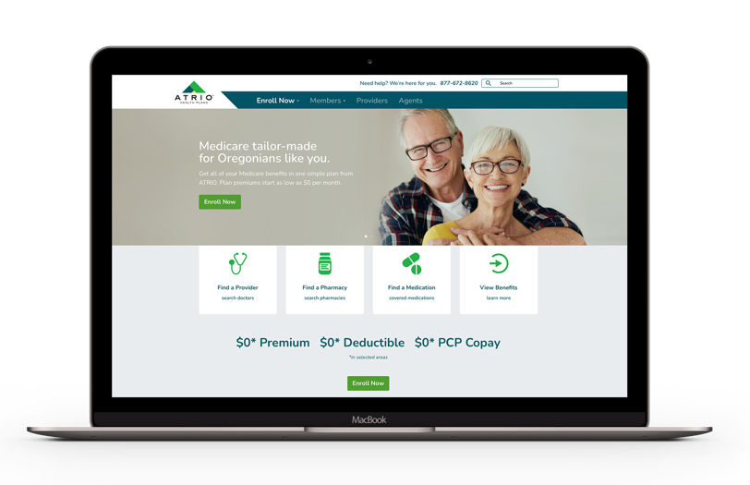
Provider Education
ATRIO to facilitate training to physicians
via webinar/In-person “lunch & learn”
ATRIO will develop affiliation letters to be sent to provider client list
Develop training materials to be utilized
by office staff and physicians
Website/Provider Portal
Provider section with information (Future)
Table sit (booth) at provider offices
Prospect educational and marketing seminars
Provider spotlight
Member retention meeting

Slide 18
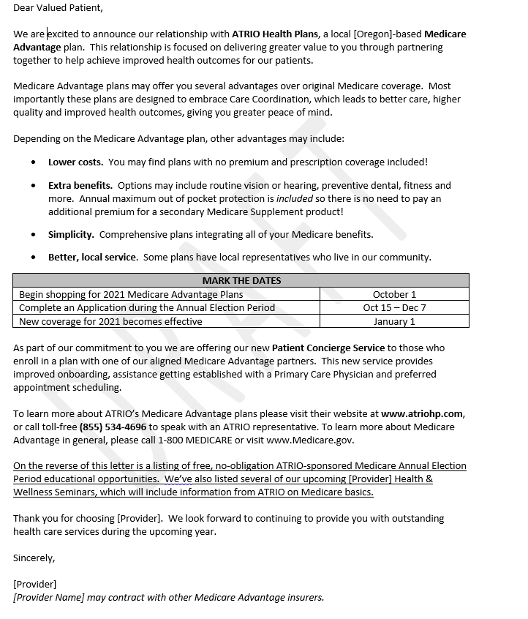
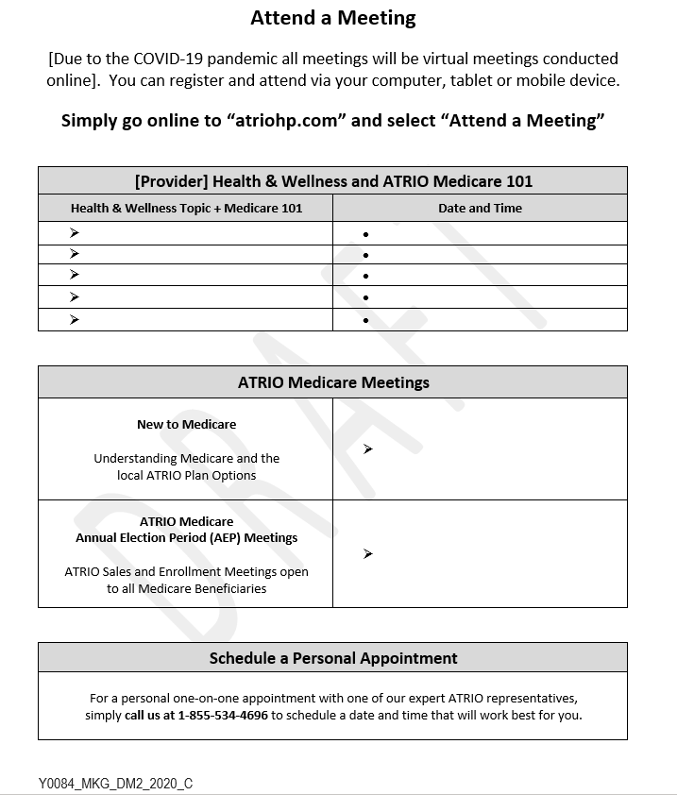
Provider Affiliation Letter

Slide 19
Outreach Objective:
Enhance and strengthen our relationships with key hospitals, physicians and physician groups by using our ATRIO leadership team, agent and agency partners, and physician outreach team:
Facilitate monthly calls between ATRIO management and physician operations
  Call Objective:
    Identify key partners
    Utilize the Medical Group advocacy team to help introduce sales team to identified key partners
    Create and maintain tracking sheet to identify PCP's with large practices – tracking will include:
      Assign territories/agents
      Identify gaps
      Create best practices
  Use tracking sheet to build a business plan with each partnership, which will include:
    Frequency of visit
    Projected outcome
    Planned Sales and Educational events
    Lunch and learns for staff
    Material needs - formularies, Medicare Guide, compliance guidelines

Slide 20
Balance Billing- In Network Providers
Providers may collect co-payments, coinsurance, and deductibles as appropriate from members.
Providers may not charge, or otherwise seek payment from ATRIO members for covered services, in the event of non-payment.
Under no circumstances will providers bill or seek payments from an ATRIO member for a service for which payment is denied or reduced because failure of the provider to comply with utilization management requirements.
Members may seek and accept financial responsibility for non-covered services
Providers and hospitals that balance bill for non-covered services are obligated to provide prior written notice to ATRIO’s members detailing their potential liability; this must include a good faith estimate of the costs. This cannot be in the form of an ABN (Advanced Beneficiary Notice of Non-coverage) or ABN like. CMS does not allow ABNs or ABN alike to be used for Medicare Advantage members.
Notes:
Claims Team

Slide 21
Balance Billing- Out of Network Providers
Providers may collect co-payments, coinsurance, and deductibles as appropriate from members
Providers may charge or otherwise seek payment from ATRIO members for covered services in the event of non-payment by ATRIO, under one of the following circumstances:
  EOC shows a clear exclusion from coverage, or
  the provider clearly communicated to the member, that the service is not covered by ATRIO
  *This cannot be in the form of an ABN (Advanced Beneficiary Notice of Non-coverage) or ABN-like notice
  Self-pay agreements must be clearly documented in member’s records
Under no circumstances will providers bill or seek payments from an ATRIO member for a service for which payment is denied or reduced because failure of the provider to comply with utilization management requirements
Only services that are reasonable and necessary under original Medicare program standards are covered, along with any applicable supplemental benefits covered under member’s benefit plan
Notes:
Claims Team

Slide 22
Medical Record Audit Report
Anytime Saint Mary’s ATRIO conducts a medical record audit report, there are two options in submitting the form:
Faxing the form to fax: 503-376-6800
Electronic submission (new)
Link: https://www.atriohp.com/medical-record-audit-response-form/
If you have any questions about the form, please reach out to compliance@atriohp.com

Slide 23
Additional Training Opportunities
The Provider Relations Team can accommodate if a provider office is unable to attend a quarterly training:
  Drop In (Provider Outreach)
  Virtual Office Hours: (Links on Provider Newsletter)
  At local office: Saint Mary’s ATRIO
  HR Department
      520 W. 6th St
      Reno, NV 89503
  At Hosting Provider Office (Scheduled meeting/In Person)

Slide 24
Thank You

